Slide 1
Diabetes Predictive Modelling
Victoria De Cun, Moein Afrouzmehr, Indronil Bhattacharjee, Fidel Gutierrez, Asif Abbas
Leveraging Machine learning for early detection

Slide 2
The Diabetes Epidemic
Ninth leading cause of death globally (WHO, 2019)
Across ages, affects 11.6% of the pop. in the U.S. (CDC, 2021)
Major risk factor for cardiovascular diseases, kidney failure

Slide 3
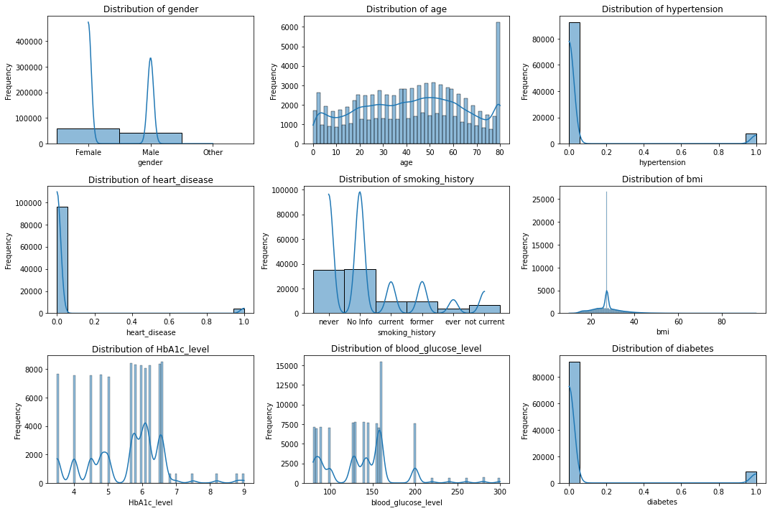
Statistical Analysis
Extensively used NumPy (Harris C.R. et. al. 2021)
Gender, smoking history – Categorical variables
Hypertension, heart disease, diabetes (class variable) – Binary
Age - Normal distribution with a spike at 80+
BMI - 5 levels from (normal to obese) – Positively skewed Lorentzian.
Blood glucose (30-300) and red blood cells indicated as HbA1c are skewed to the left.

Slide 4
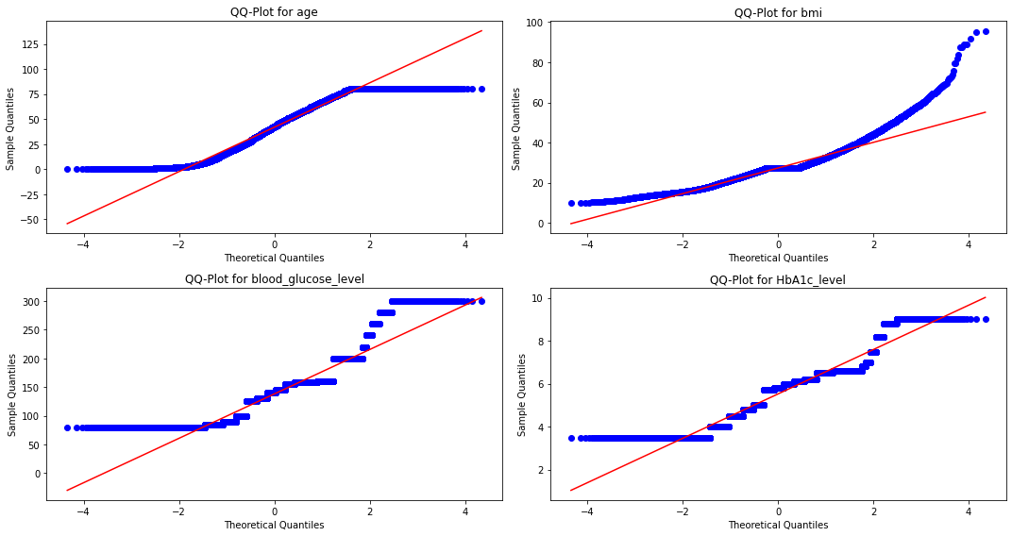
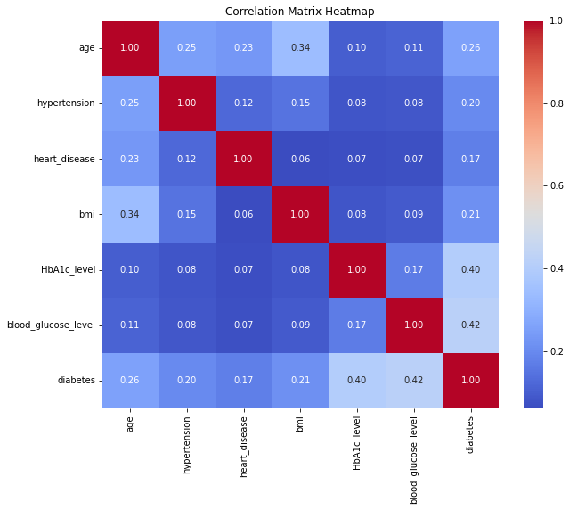
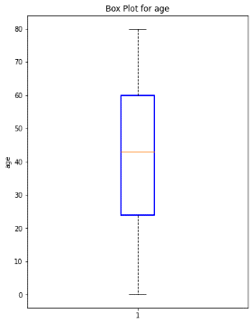
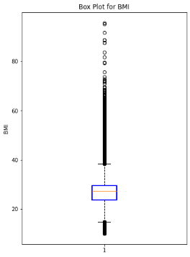
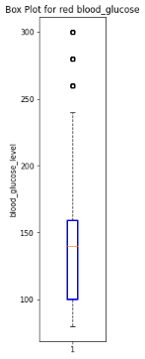
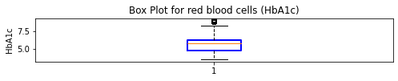
Statistical Summary
Pearson’s correlation table for the numerical features, including, age, hypertension, heart-disease, bmi, HbA1c_level, blood glucose level, and diabetes.
(a)
(b)
(c)
(d)
QQ-plot for (a) age, (b) bmi, (c) blood glucose, and (d) HbA1c.
Boxplots of (a) age, (b) bmi, (c) blood glucose level, and (d) HbA1c level.

Slide 5

Decision Tree
Much like a real tree, starting with a root node that branches into additional nodes, until we reach an output.
Each node represents a test, and the branches the outcome.
Accuracy: 95.66%
Running Time: 0.015 s

Slide 6

Random Forest
Leverages the power of multiple trees
More accurate, but computationally intensive
Accuracy: 96%
Running Time: 0.82 s

Slide 7

Gradient Boosting
Just like a RF, uses multiple trees
New trees are added to correct residual errors, and increase accuracy
Accuracy: 95%
Running Time: 2.22 s

Slide 8

kNN
Find the k nearest neighbours.
Take the majority vote to obtain the class label
Accuracy: 94.7%
Running Time: 0.004 s

Slide 9
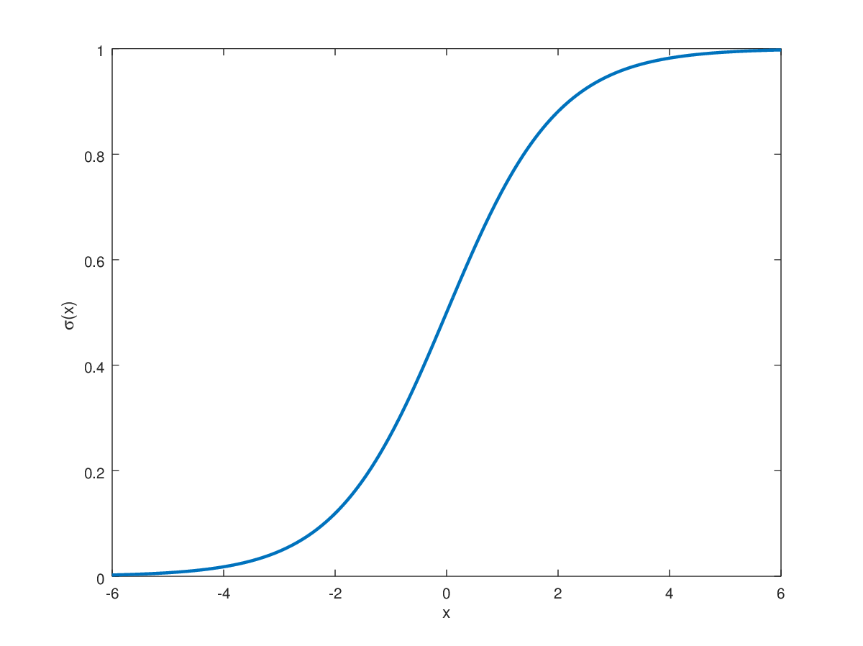
Logistic Regression
Based on the logistic (sigmoid) function
The goal is to maximise the likelihood of the observed data
Accuracy: 96%
Running Time: 0.03 s

Slide 10
Support Vector Classifier
Simple premise – Find the hyperplane that maximises the distance between itself and support vectors
Real-world data is often too complex to fit
Kernels map data to a higher dimension.
Choice of an appropriate kernel is paramount

Slide 11

SVC - Linear
Linear kernel – no mapping
Extremely simple, but could lead to underfitting
Accuracy: 95.66%
Running Time: 0.13 s

Slide 12
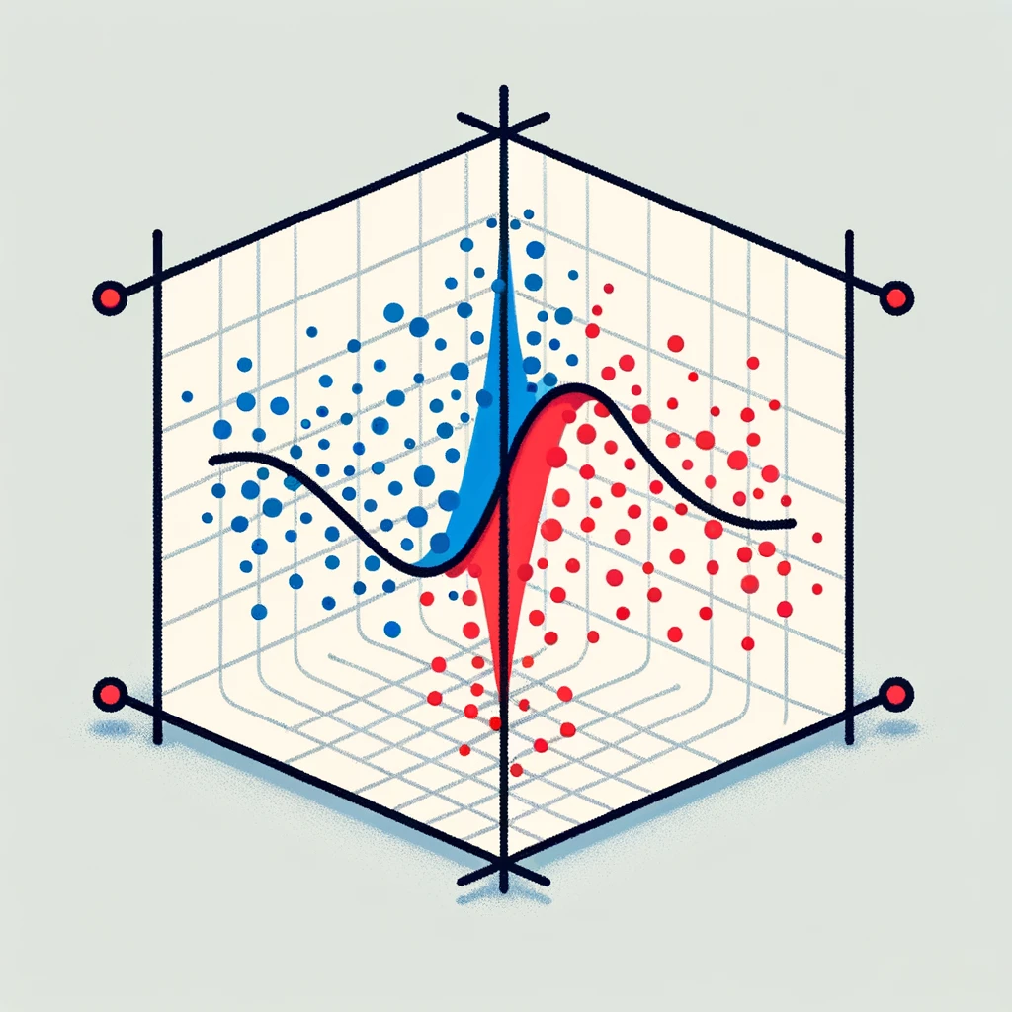
SVC - RBF
RBF Kernel – Non linear
Can capture more complex boundaries
Requires careful tuning of hyperparameters
Accuracy: 94.2%
Running Time: 0.10 s

Slide 13
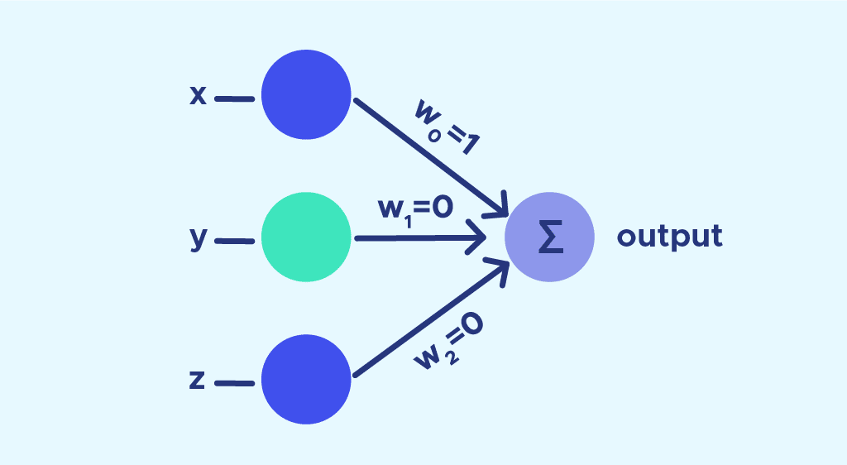
Perceptron
Simplest neural network
Assigns a weight to each feature, and the weighted sum is passed to an activation function
Weights adjusted based on error
Accuracy: 93%
Running Time: 0.003 s

Slide 14

ANN
Consists of interconnected neurons
4 layer ANN – 1 input, 3 hidden
Accuracy: 95%
Running Time: 26.10 s

Slide 15
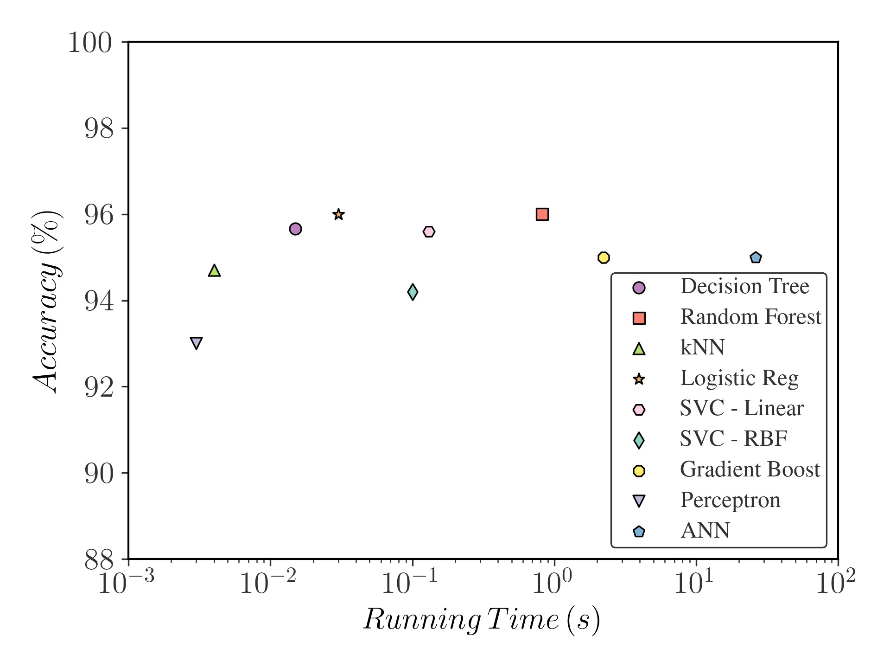
Conclusion

